Slide 1

News analysis managerial economics
ADITI SINGH

Slide 2

ANALYSIS ON REGULATING GIG BASED WORK
.

Slide 3
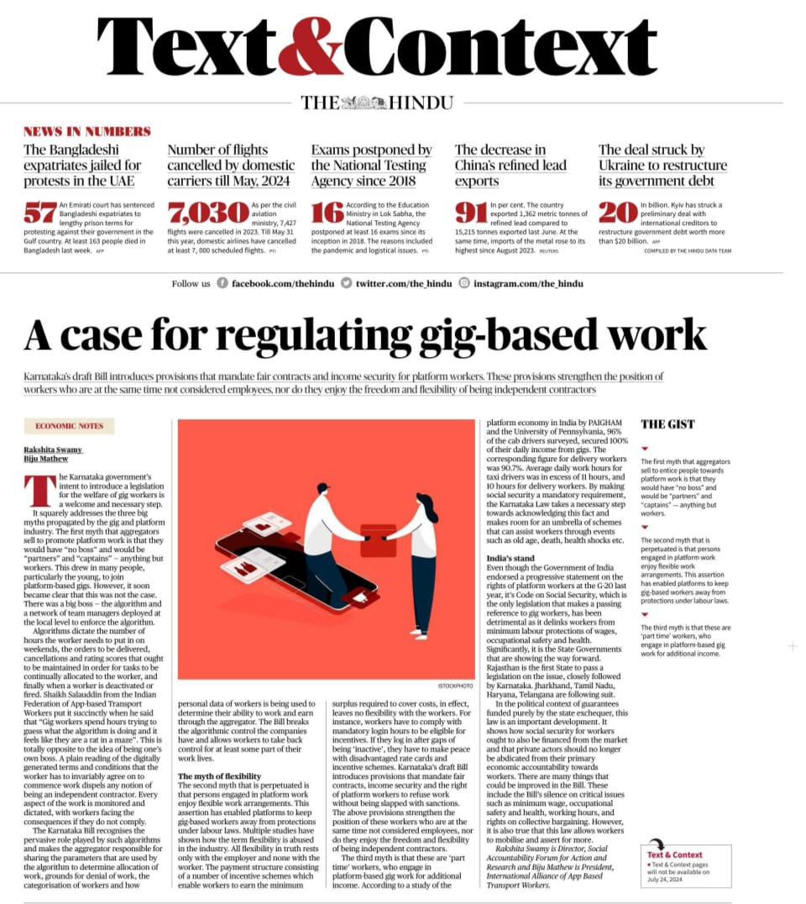
KEY POINT
AGGREGATORS SELL TO PROMOTE PLATFORM WORK IS THAT THEY WOULD HAVE “NO BOSS “AND WOULD BE “PARTNERS” AND “CAPTAINS” –ANYTHING BUT WORKER
GIG WORKERS SPEND HOURS TRYING TO GUESS WHAT THE ALGORITHM IS DOING AND IT FEELS LIKE THEY ARE A RAT IN A MAZE.

Slide 4
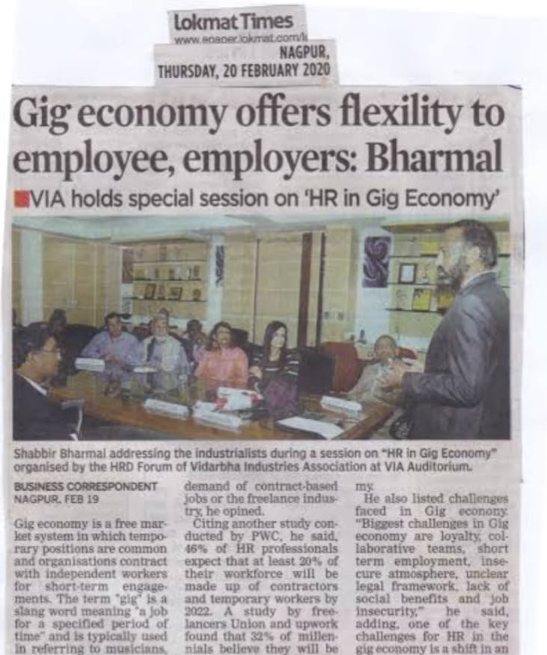
KEY POINT
THE PERPETUATED IS THAT PERSONS ENGAGED IN PLATFORM WORK ENJOY FLEXIABLE WORK ARRANGEMENTS. THIS ASSERTION HAS ENABLED PLATFORMS TO KEEP GIG BASED WORKERS AWAY FROM PROTECTION UNDER LABOUR LAWS.
THESE ARE ‘PART TIME ‘ WORKER, WHO ENGAGE IN PLATFROM –BASED GIG WORK FOR ADDITIONAL INCOME.

Slide 5
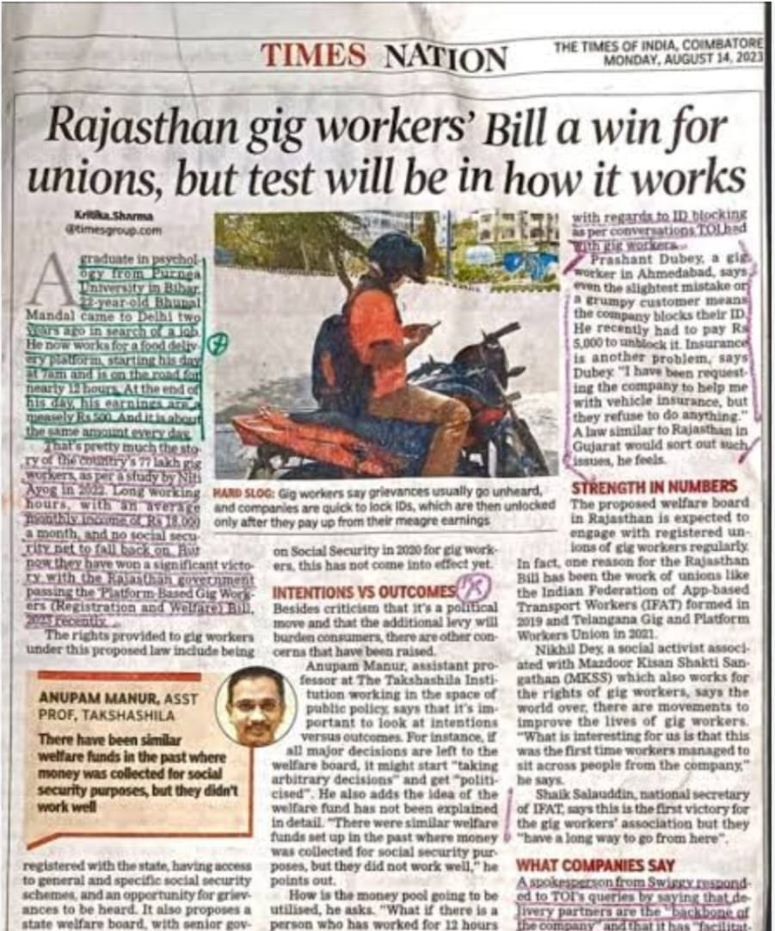
KEY POINT
The new Rajasthan Platform-Based Gig Workers (Registration and Welfare) Act 2023 is the first-of-its-kind ground-breaking piece of legislation.
It aims to establish a welfare board and a dedicated social security fund for platform-based gig workers in the stat

Slide 6
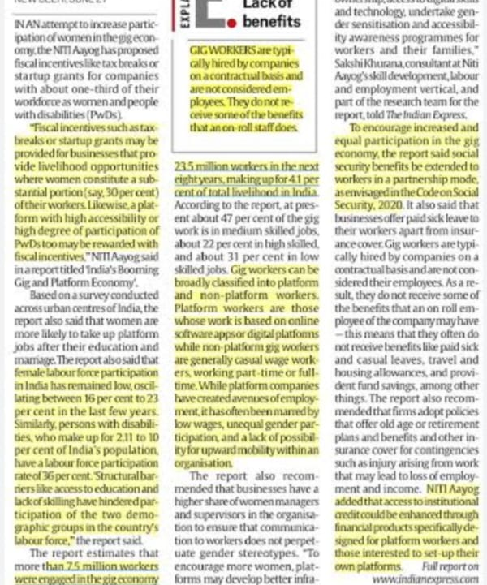
KEY POINT
Niti Aayog’s report ‘India’s Booming Gig and Platform Economy’, recognises lack of job security, wage irregularity and uncertain employment status for workers, as top challenges in the sector
It recommends extending social security provisions such as sick leave, insurance and pension to gig workers and their families.

Slide 7
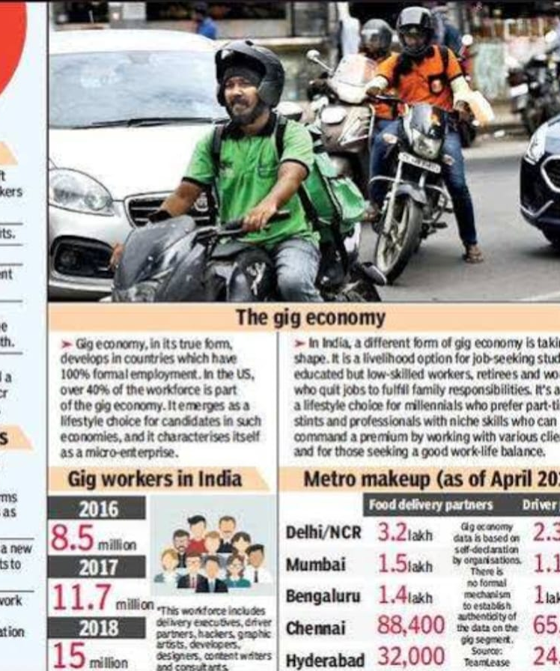
KEY POINT
The role of gig workers has been gaining importance as they infuse flexibility and talent availability in the job market.
The future workforce will indeed be a blended model -Wherein the gig economy is expected to play an important role not only as a talent management strategy,But also accelerate job creation and boost the country’s economic growth.

Slide 8
SUMMARY
Long working hours: Almost a third of app-based cab drivers work for over 14 hours a day, while more than 83% work more than 10 hours and 60% work over 12 hours.
Social disparities make the situation worse, with over 60% of the drivers from SCs and STs working for over 14 hours a day.
Low earnings: Over 43% of participants in the study earn less than ₹500 a day or ₹15,000 a month, after deducting all their costs.
Over 80% of app-based cab drivers were not satisfied with the fares offered by the companies, while over 73% of app-based delivery persons showed dissatisfaction with their rates..

Slide 9
.
Stress and potential health issues: Due to the demanding work hours, drivers are physically exhausted.
They are exposed to an increased risk of road traffic accidents, especially due to the 10-minute delivery policy of certain e-commerce platforms
It called on the government to exercise oversight on the fairness of algorithms and mechanisms used by platforms to monitor such workers.

Slide 10


